Slide 1


Generalized Ho-Lee Model for Game Option Bonds
May 2025
LEHIGH UNIVERSITY
By Gregory Radu Colonescu

Slide 2

Agenda
May 2025
LEHIGH UNIVERSITY
1
2
3
Background
The Paper
Expansions

Slide 3

Background
May 2025
LEHIGH UNIVERSITY
1
Callable and Puttable Bonds
=> Game Option Bonds
🏦 Callable Bonds
Analogous to call options
📉 Putable Bonds
Analogous to put options
♟ Game Option Bond
Combination of both callable and putable features
Notes:
Callable Bonds
Definition: Bond that can be redeemed by the issuer before maturity at a set call price.
Issuer's Perspective: Like holding a call option; used to refinance at lower interest rates.
Impact: Lower bond price → higher yield to compensate investors for call risk.
Putable Bonds
Definition: Bond that can be sold back to the issuer by the holder before maturity at a set put price.
Holder’s Perspective: Like owning a put option; protects against rising interest rates.
Impact: Higher bond price → lower yield since the investor has an option.
Game Option Bond
Combination of both callable and putable features.
Each party can exercise at discrete times, leading to strategic interaction.
Valuation Challenge: Must model it as a zero-sum game between issuer and holder.

Slide 4
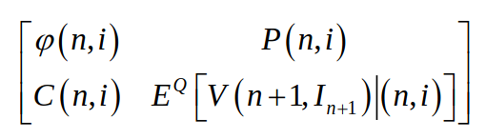
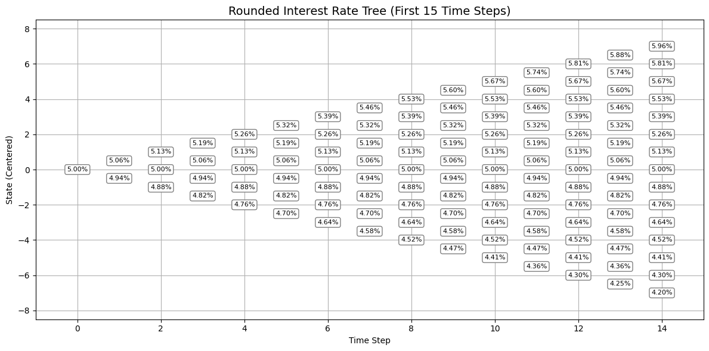
The Paper
May 2025
LEHIGH UNIVERSITY
2
Methodology and Minutia
Generalized Ho-Lee Model
Stochastic Game Formulation

Slide 5
Expansions
May 2025
LEHIGH UNIVERSITY
3
What’s missing
Application to CDS
More analysis of change in change of volatility and interest rate in conjunction
No credit risk
A lot of constants
More duration analysis

Slide 6
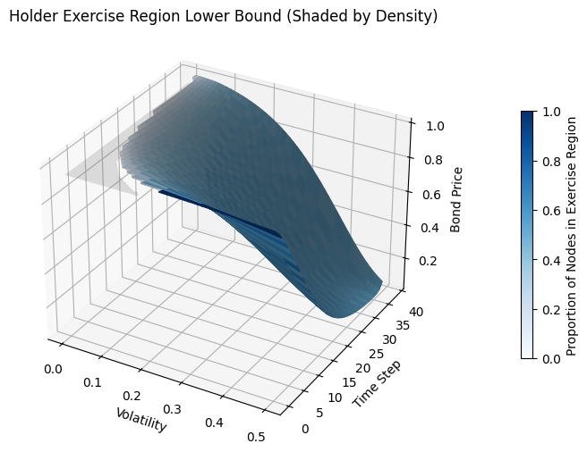
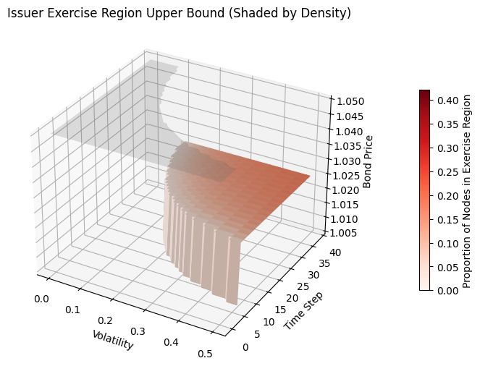
Extra Analysis, part 1
May 2025
LEHIGH UNIVERSITY

Slide 7
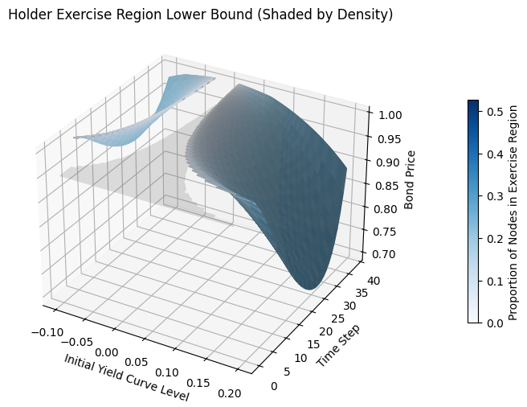
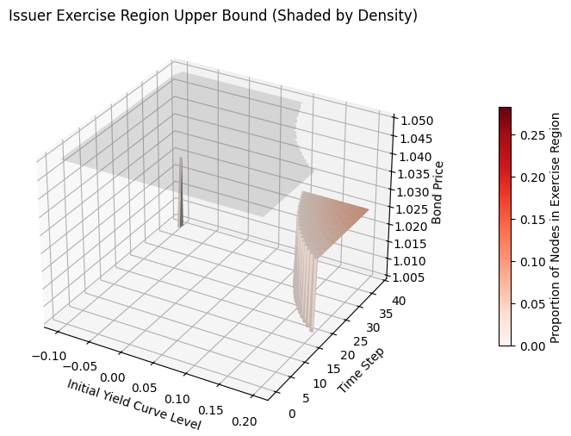
Extra Analysis, part 2
May 2025
LEHIGH UNIVERSITY

Slide 8

Thank you
May 2025
LEHIGH UNIVERSITY

